Slide 1
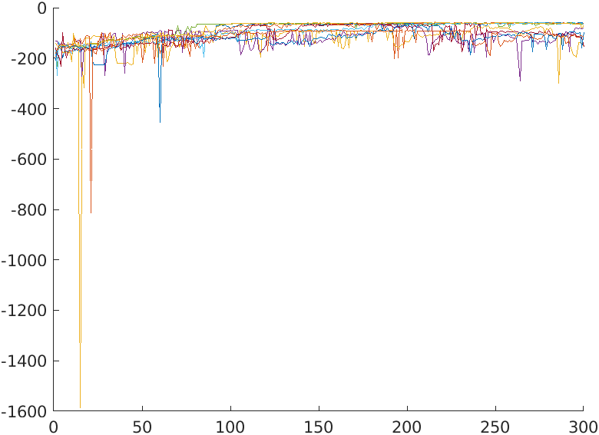
Case 5: std=0.1 (16,32,32),min:57.0

Slide 2
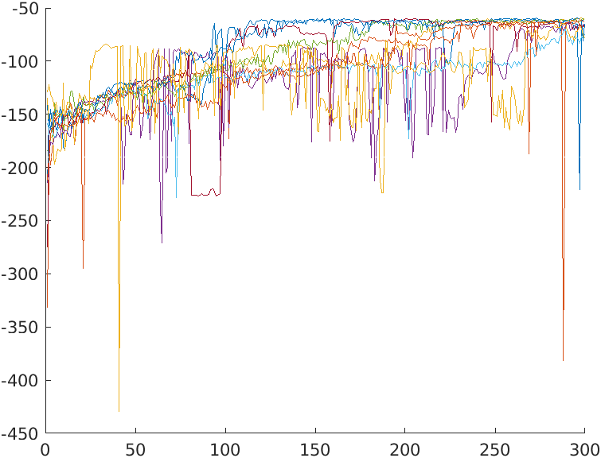
std=0.05 (16,32,32)
std=0.1 (16,32,32)

Slide 3
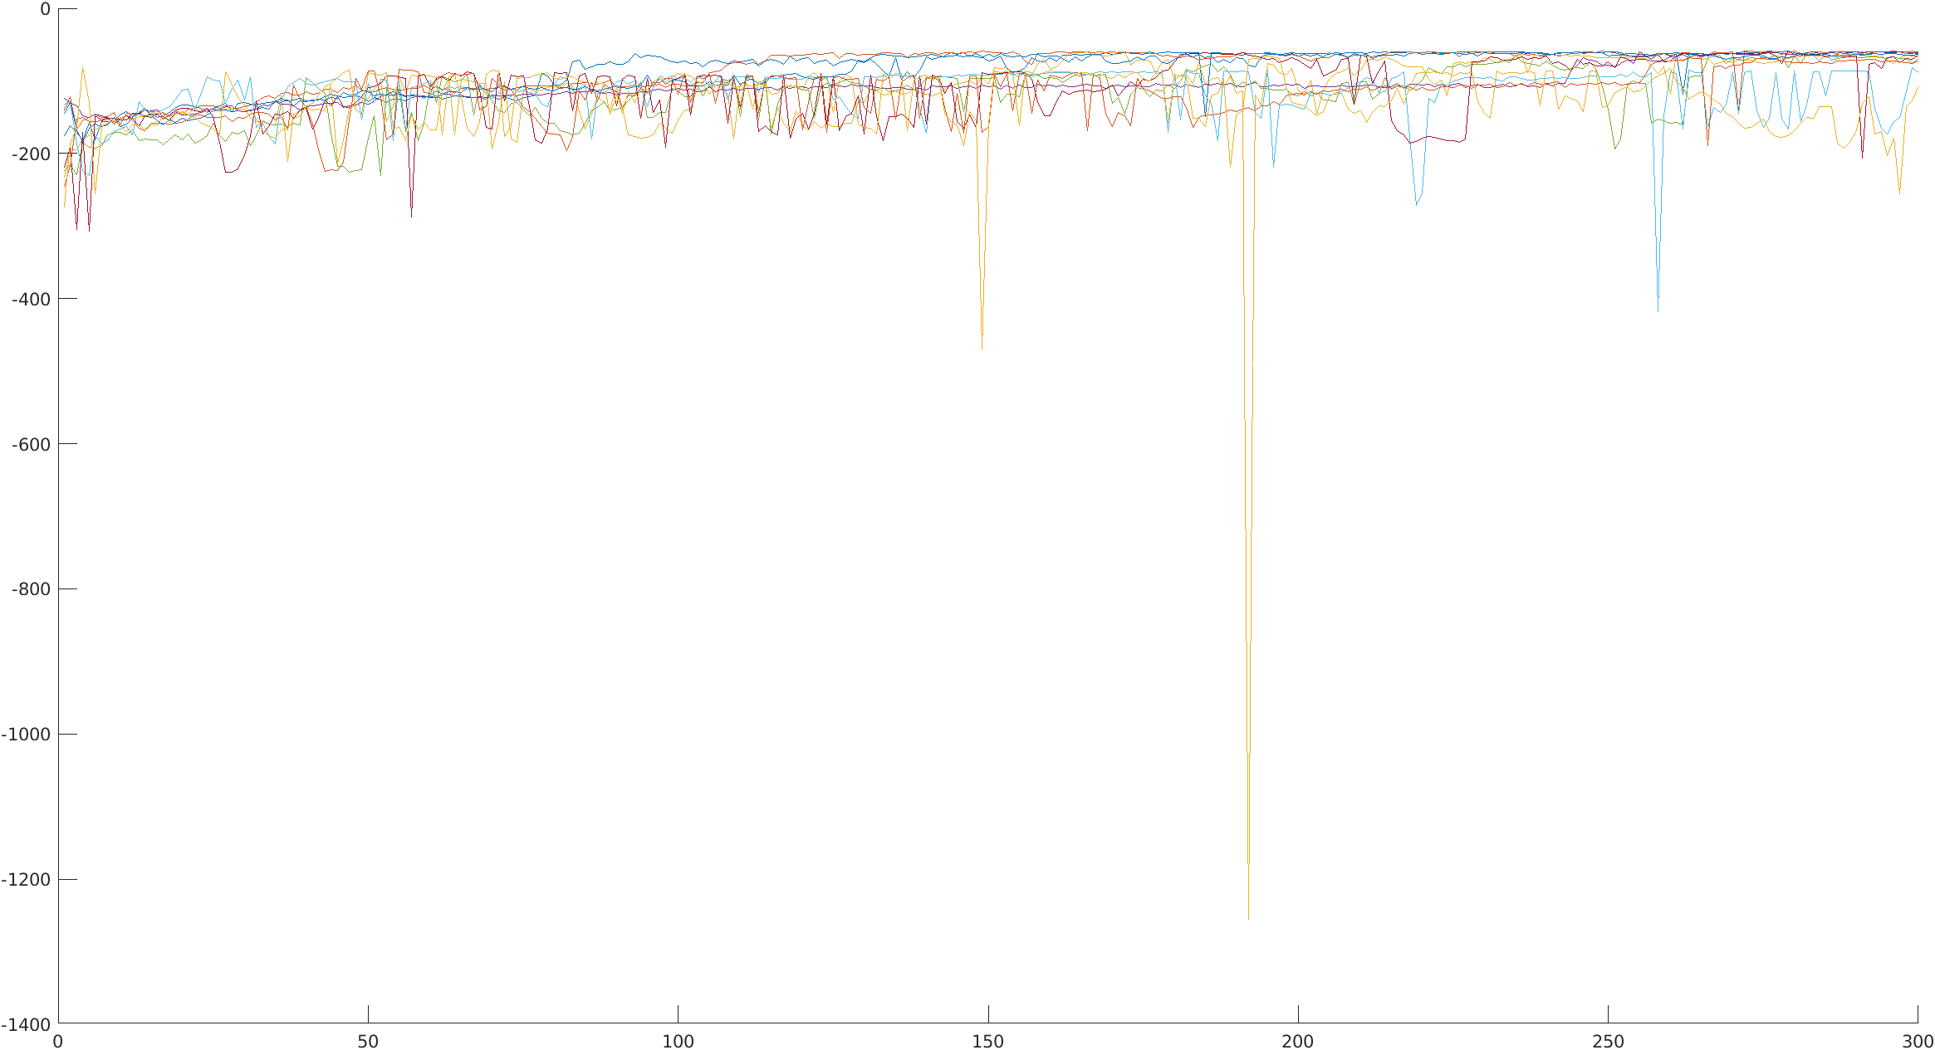
Add network nodes (32,64,64)

